Slide 1
HTA - SANTA MONICA JOBS INITIATIVE PROGRAM

Slide 2
City of Santa Monica
Visitors from around the world flock to Santa Monica for its views of the Pacific shoreline, the Third Street Promenade, the Iconic Route 66 and more….

Slide 3
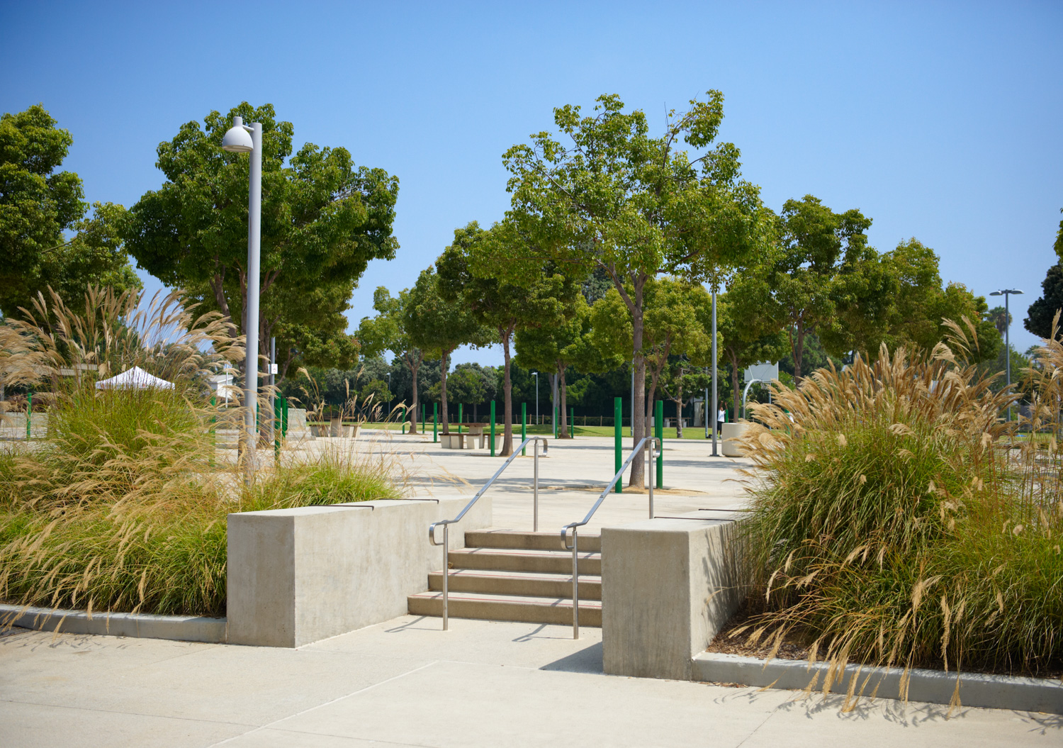
Virginia Avenue Park Community Center
The HTA provides a variety of workforce development, apprenticeship and training programs to help low-income residents of the City of Santa Monica receive training opportunities that lead to careers in the hospitality and food service sector.
We are located at the Virginia Avenue Park Community Center.

Slide 4
Our Goals
CAREER
BETTER JOB
ANY JOB
For union members – upskilling and growing into new positions
For job seekers – get the job and keep the job!
Notes:
Those working at union locations such as the Viceroy Hotel, The Proper Hotel, LAX

Slide 5
What We Do
The HTA provides a variety of workforce development, apprenticeship and training programs to:
Create a well-trained workforce for the hospitality sector;
Create a healthier work environment by teaching safety, sanitation and ergonomic skills;
Develop confident, competent workers who can perform entry level job skills;
Provide management with a well-trained workforce to help grow their businesses.

Slide 6
HTA’s Vision
2028
Nearly 100 hotels are in the pipeline to be built by 2028
Between now and 2028 Los Angeles will host
The Olympics
FIFA World Cup
We are expecting a need for nearly 15,000 NEW jobs within the hospitality sector
Number one employer in LA County
Diversity of opportunity and experience
Job security
Safe and fair work environment
Notes:
Dafne

Slide 7
HTA Program Courses
DISHWASHER/STEWARD (36 HOURS)
This course focuses on the operation of commercial dishwashing machines used at restaurants, hotels, event venues, etc.
The class includes 3-days of training to teach students how to use a dishwasher plus 6-hours of training modules for Customer Service, Server skills, and the National Restaurant Association’s ServSafe Food Handler Certification.
BARISTA (42 HOURS)
The Barista course focuses on the history, preparation, and service of coffee through lecture and hands-on training and includes:
4-hour Barista pre-requisite class;
24 hours of Barista training;
6-hour module of Customer Service training;
6-hour module of Server training; and
Includes a ServSafe Food Handler Course.

Slide 8
HTA Program Courses (continued)
ENGLISH LANGUAGE LEARNER (ELL) - PREP COOK TRAINING (108 HOURS)
This 18-day training program prepares participants to work in hotel banquet departments, supermarket deli departments, and with other employers as an entry-level Prep Cook.
Participants will learn kitchen safety and sanitation, allergen safety, safe and efficient ergonomics, knife safety & knife skills, COVID prevention, fruit, vegetable, and sliced cheese and meat platter production; and buffet set-up.
Speed drills encourage students to work quickly, safely and efficiently.
Participants will also gain computer, resume-writing and interview skills through hands-on training and will learn the basics of applying for jobs, customer service, and teamwork .
Work-related ESL training will help prepare the participants for interactions with their customers and colleagues within the workplace.
CERTIFICATES: ServSafe Food Handler Certificate, HTA Industry-Recognized Certificate

Slide 9
HTA’s Program Courses (continued)
ALCOHOL & BEVERAGE SPECIALIST (24 HOURS)
This course is led by HTA’s chefs and food industry specialists and includes 6-days of training incorporating our signature classes covering:
Customer Service 101 & 102 –emphasizes both the skills and the tools needed to become a successful front-of-house hospitality worker and covers the fundamentals of providing exceptional customer service while working with a front-of-house service team. Topics of discussion include defining what comprises exceptional customer service and hospitality, constructive communication skills, professional conduct and deportment, teamwork, conflict resolution, and working with a diverse team of employees.
Server Training – will cover the fundamentals of working with a service team. Demonstrations of service techniques, pouring wine, setting and clearing tables, polishing service-ware, folding napkins, carrying trays of various sizes and shapes, and usage of basic serving staff tools will be taught, as will the fundamental principles of sales techniques, proper service etiquette, customer interaction and customer service.
Wine 101 – will teach the fundamental definition, concepts and techniques involved in wine sales and consumption using lectures along with demonstrations to teach the intricacies of wine.
Wine 102 – will focus on the intricate nature of wine through an understanding of the different major types of wine produced throughout the world, along with the basics of developing a wine tasting regimen to help develop a greater appreciation of the wide variety of wine profiles. Proper wine storage and correct wine service, understanding of choices of glassware for different wines, and wine and food pairing will also be covered.
Liquor 101 – will teach the fundamental definitions and terminology of liquor and the bar, the complexities of mixing drinks, recipes, proper glassware, and drink presentation. Students will gain an understanding of liquor through lectures, demonstrations, review of concepts and techniques involved in the process of making liquor and consumption.

Slide 10
HTA Program Courses (continued)
BARISTA (42 HOURS)
The Barista course focuses on the history, preparation, and service of coffee through lecture and hands-on training and includes:
4-hour Barista pre-requisite class;
24 hours of Barista training;
6-hour module of Customer Service training;
6-hour module of Server training; and
Includes a ServSafe Food Handler Course.
SERVSAFE FOOD HANDLER CERTIFICATION (6 HOURS)
This class is designed for those handling food product. The course includes six hours of classroom instruction, and afterward, students take the California ServSafe Food Handler certification exam. The course is an introduction to environmental sanitation and safety in a food production area
Students learn to:
Assist in preventing the occurrence of foodborne illness and recognize the risks faced by a food service establishment
Protect food and food service equipment from contamination; and dentify the principles and practices involved in purchasing, preparing, storing, and serving food in a sanitary manner and the ability to implement that knowledge in a kitchen environment.
CERTIFICATES: Upon successfully completing the class and passing the ServSafe exam, students will receive a ServSafe Food Handler Certificate

Slide 11
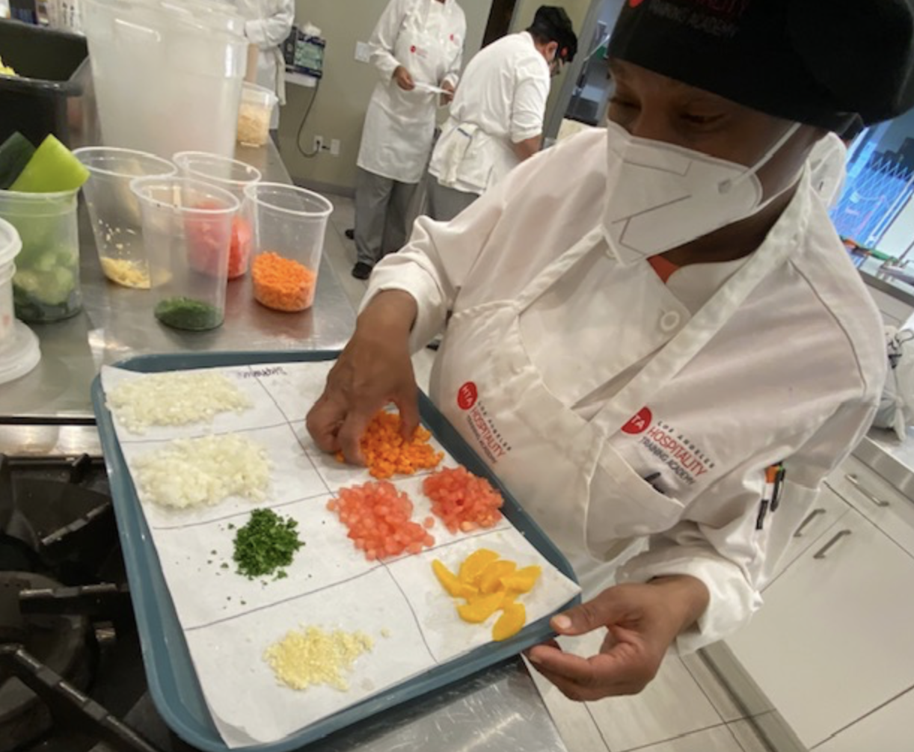
Culinary Program
Summary:
8 Weeks, 180 hours of hands-on training
Kitchen safety and sanitation
Culinary terminology, equipment, and knife skills
Poultry and fish fabrication
Preparation of stocks, foundational sauces and soups
Banquet preparation
Certifications: US DOL Registered Apprenticeship Certificate + 3 other recognized within the industry
Notes:
Jose Luis and Jennifer to talk about content of class, curriculum, what will they learn, etc. (Jen and Jose Luis please feel free to edit this part)

Slide 12
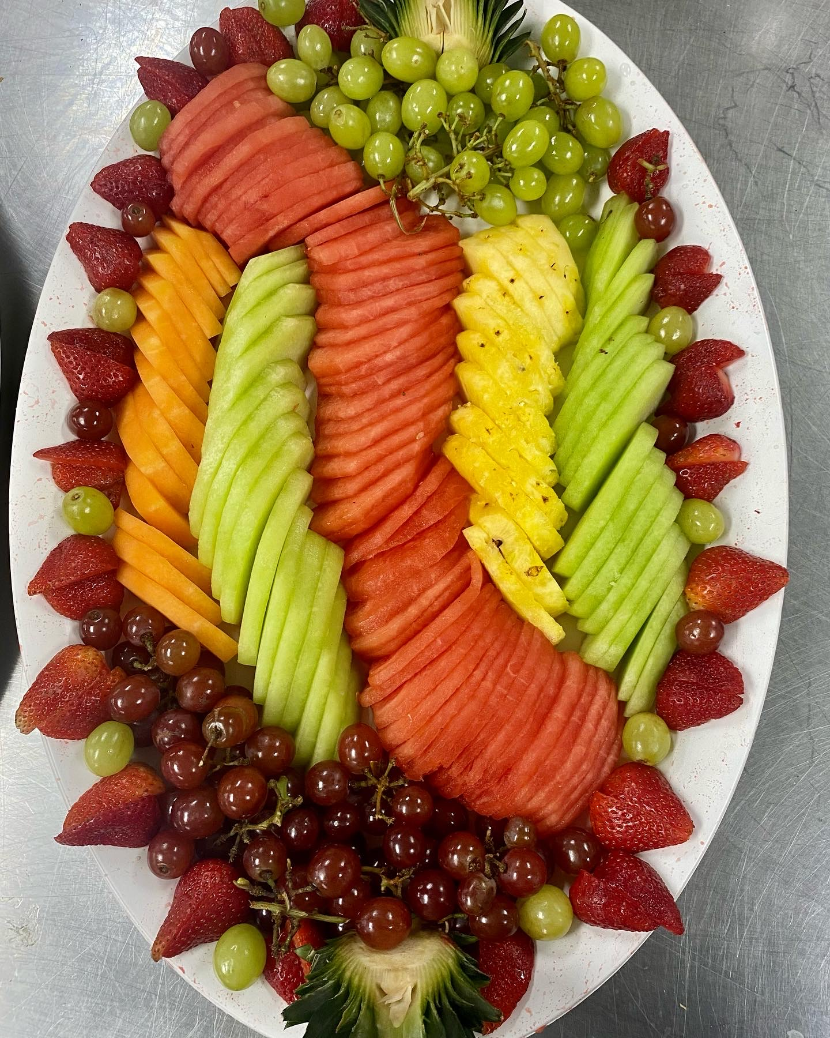
HTA Prep Cook Pre-Apprenticeship Training
20 Days, 108 hours of hands-on training
Kitchen safety and sanitation
Culinary terminology, equipment, and knife skills
Preparation of fruit platers, sandwiches, and charcuterie boards
Certifications: Always Food Safe Food Handler Certificate, CA Prep Cook Certificate

Slide 13
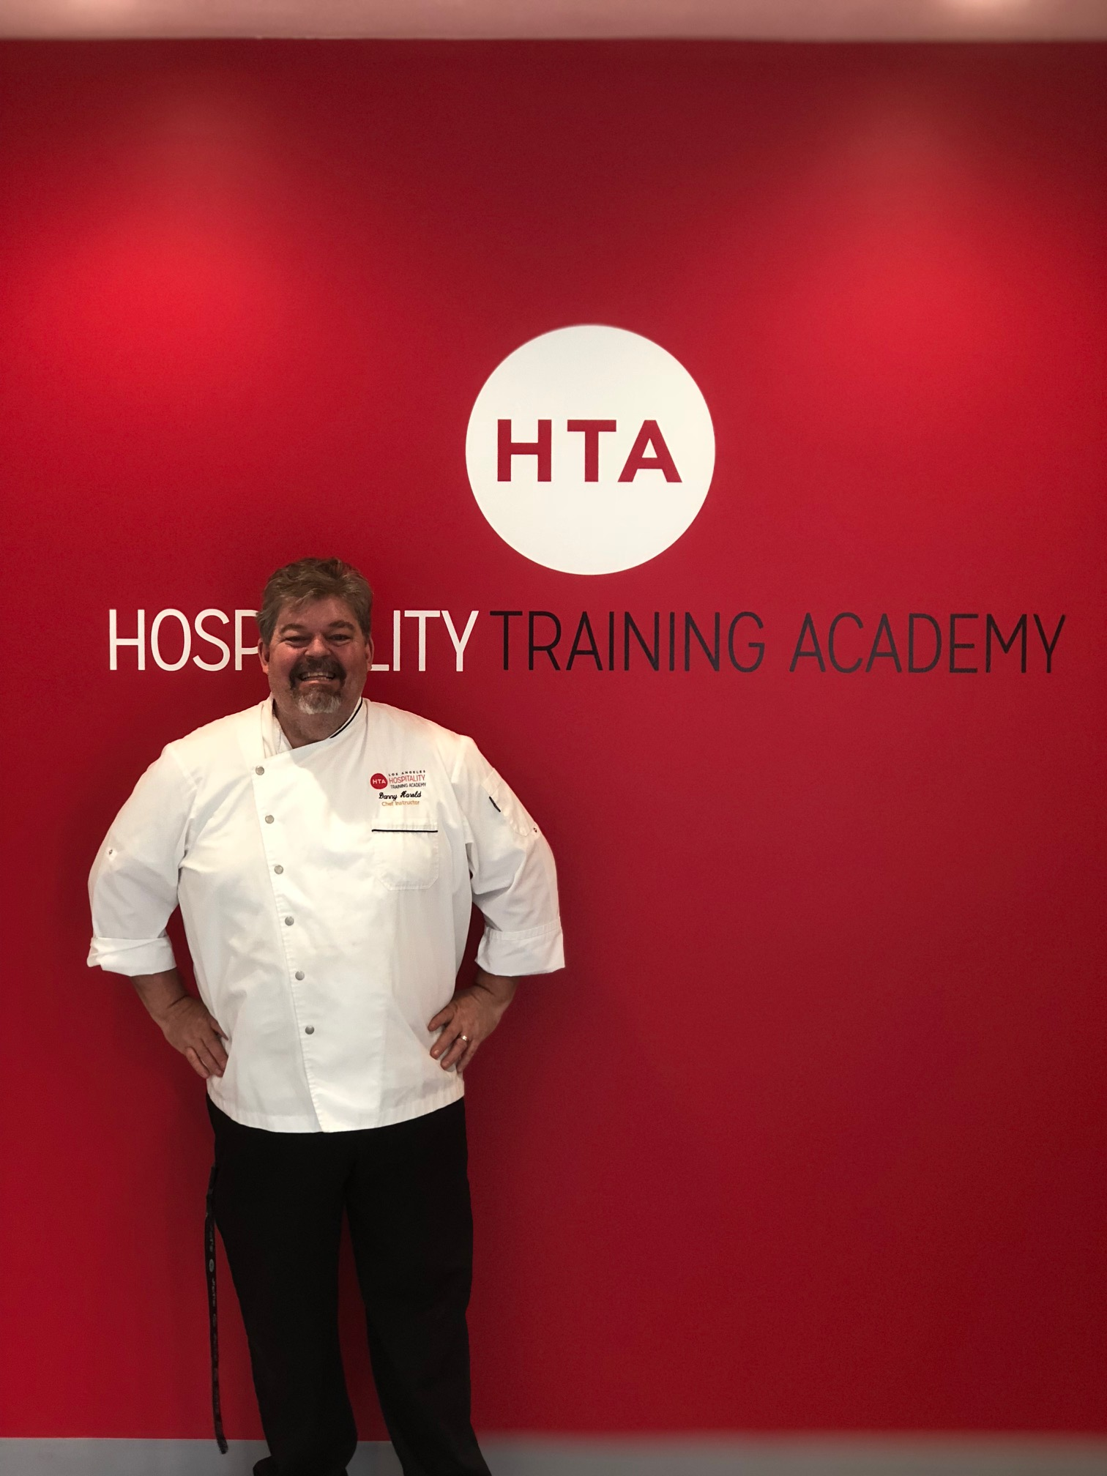
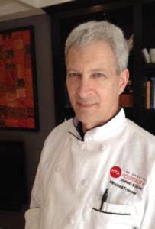
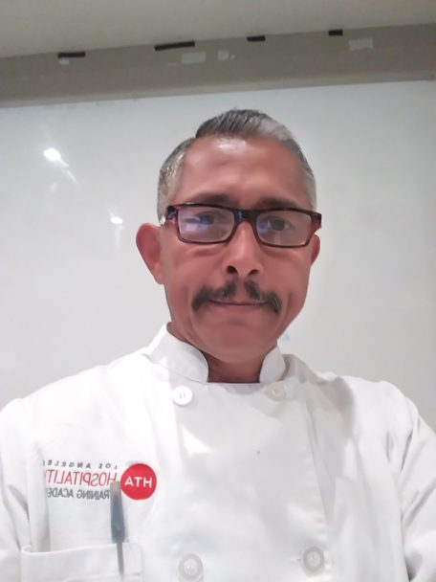
The Culinary Instructors Instructors
Chef Danny Harold
HTA Culinary Instructor
Chef Mitchell Frieder
HTA Lead Culinary Instructor
Chef Paul Blanco
HTA Assistant Culinary Instructor

Slide 14
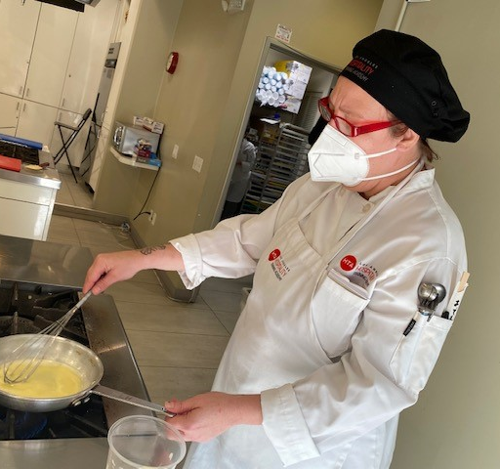
HTA Culinary Apprenticeship student Rosa practicing onion dicing techniques and Cari creating a beurre blanc sauce.

Slide 15
HTA Training Kitchen Banquet Preparation for Culinary Apprenticeship Program

Slide 16
HTA Culinary Apprenticeship 2024 Class Schedule
Dates:
Prep Cook - Morning Class March 18 - April 12 8:00 a.m.- 02:00 p.m.
Line Cook – Morning Class May 6 – July 1 8:00 a.m.- 02:00 p.m.
Prep Cook- Evening Class June 6- July 3 3:00 p.m. - 9:00 p.m.
Location:
Hospitality Training Academy Kitchen (HTAK) 1234 South Western Avenue Los Angeles, CA 90006
Contact Us Today:
Phone: (310) 994-5426
Email: info@lahta.org

Slide 17
Employer Partners
LAX Airport
Great stepping stone
3,000 – 4,000 Currently employed and on the rise
Obtain experience in a fast paced work environment
Hotels throughout Los Angeles, Anaheim, Santa Monica and the Century Corridor
Notes:
We also work with sports facilities and venues like Dodger Stadium, Staples Center, The forum….
The New Rams will be included and The New LAFC Soccer stadium, and the Stub Hub
With some positions are seasonally based and clients can take additional work at other locations within the same company.
Its called “The Tour” some Dodgers stadium workers will go from there to Staples Center for the basketball season and or Concerts there and the Convention Center
talk in dept about the pros and cons about each...

Slide 18
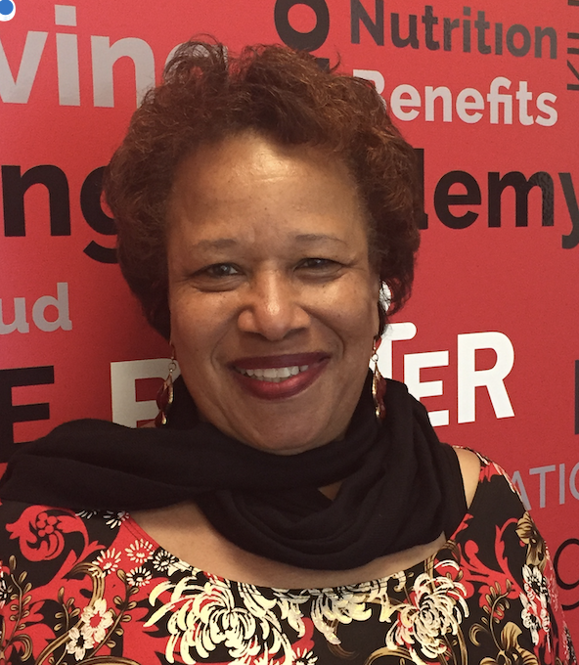
Contact Information
Karen Mitchell
Employment Specialist
Direct: (310) 529-6638
Email: karen.mitchell@lahta.org
Website: http://www.lahta.org
@LosAngelesHTA
@HTALosAngeles
@Hospitality Training Academy

